Slide 1
UPLOADING AN OBJECT TO AN S3 BUCKET USING BASH SCRIPT AND AWS CLI
BY: CHINWUBA CHIDUBEM

Slide 2
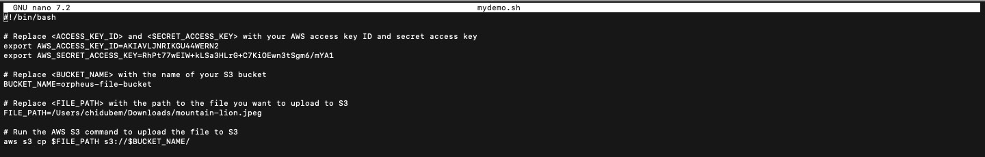
ENTER ACCESS KEY DETAILS

Slide 3
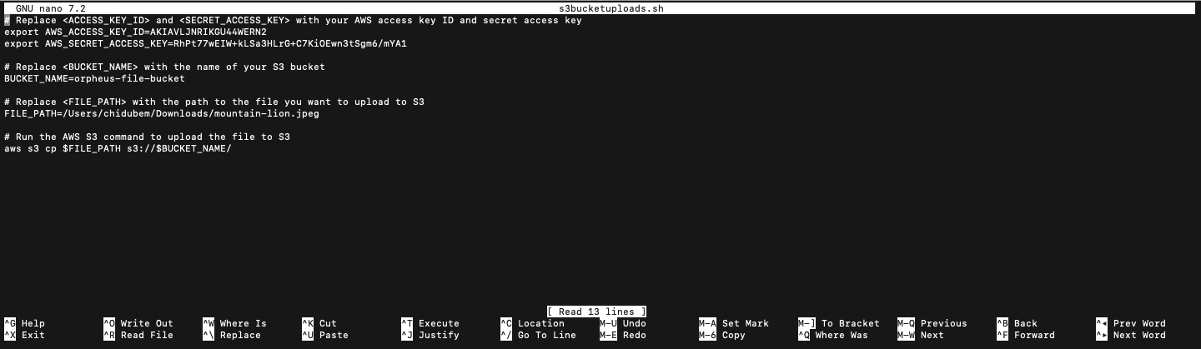
WRITE THE SCRIPT

Slide 4
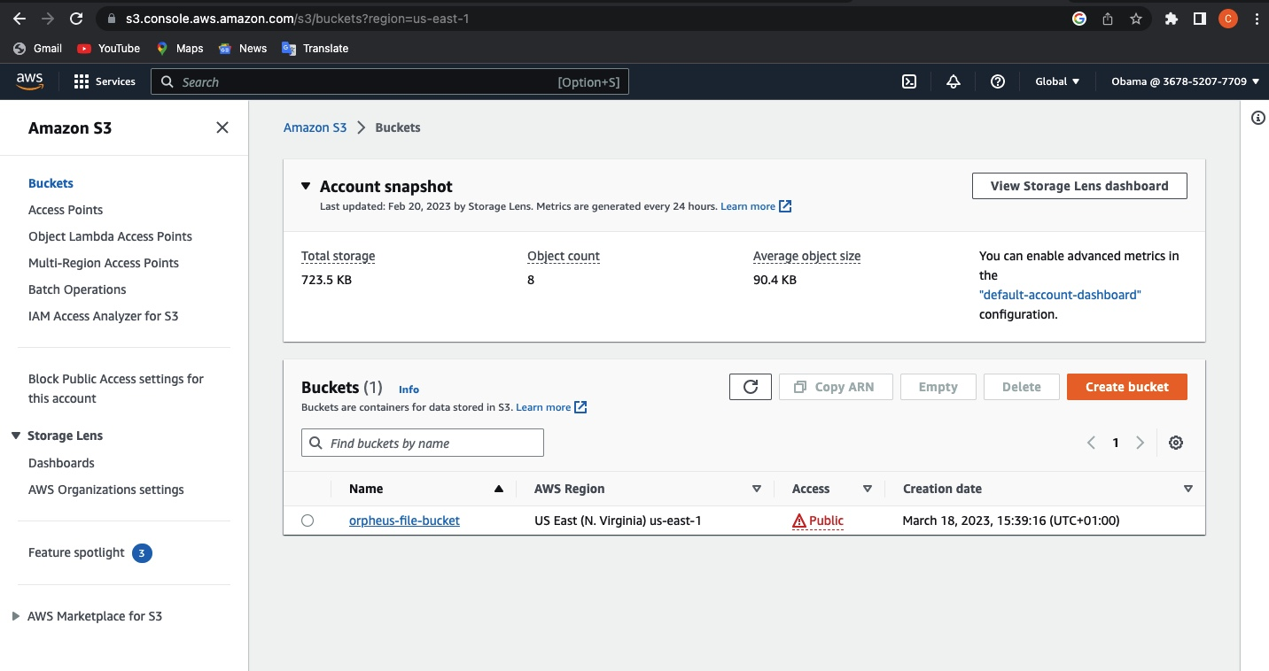
AWS S3 BUCKET

Slide 5
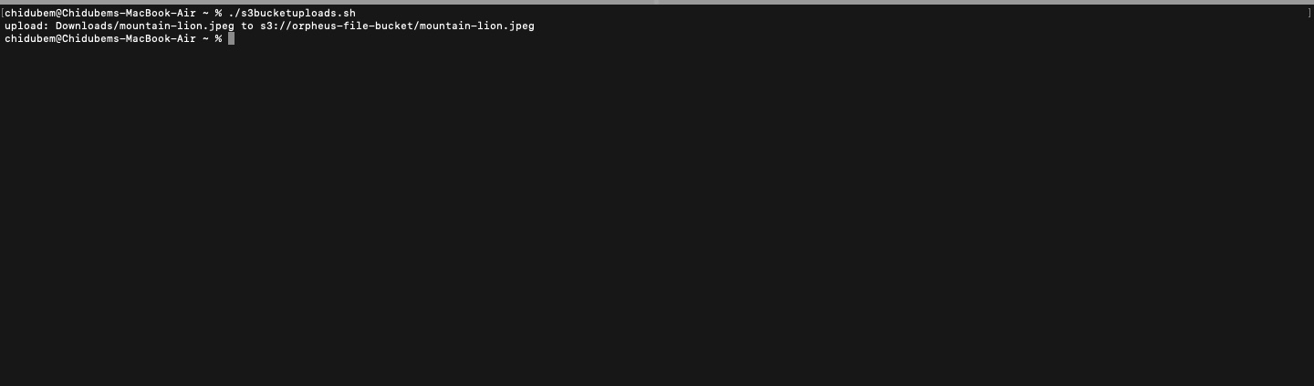
Object Upload Successful

Slide 6
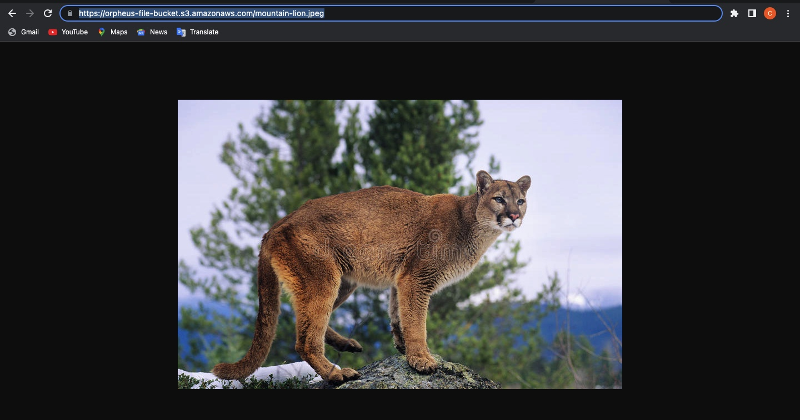
Object in the S3 Bucket

